Slide 1
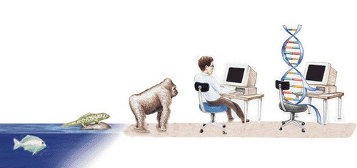
Genetic Algorithms Advanced Computational Modeling
Genetic Algorithms
G.D. Illeperuma
Dept of Physics
Open University of Sri Lanka

Slide 2

What we will learn….
Inspirations for the GA
Basic GA rules
A simple example
Possible variations for GA
Applications of GA
References

Slide 3
Optimization
Some problems are known as NP hard and their solution space increases exponentially as the number of possibilities increases
Some of these problems can not be solved using traditional techniques
Linear / Non linear / Dynamic programming
Queuing
Scheduling and Assignations
Transportation and Inventory

Slide 4
Non Traditional Techniques
Simulated Annealing
Ant colony optimization
Random cost optimization
Genetic Algorithms
Cellular automata

Slide 5

Inspiration for the GA
Like most of AI techniques this one too is borrowed from the nature..
‘Survival of the fittest’ is a method used in nature to find the most suitable living beings in a changing environment.
It is the same technique used in GA.
We try to find the ‘fittest’ solution to a problem.

Slide 6

Introduction
Genetic algorithm is an optimization technique.
It does not guarantee to find the optimal solution
How ever it will give a reasonable solution with a minimal amount of time

Slide 7
When to use GA
There are different techniques used to find optimal solutions for a problem.
For example one may try the brute force attack. (try out all the possible answers and select the best one).
Although this provide the best solution, it will require massive amount of computing resources. You may not want to wait for 10 years to find the best packing method for a fruit!

Slide 8

Most of the time we do not need the ‘best’ solution. We only need a ‘good’ solution in reasonable amount of time.
This is where GA steps in. It can produce a great result, in a fraction of time taken by the brute force attack.

Slide 9

Limitations
Problem must be an optimization problem.(It cant be used to FIND THE solution, but rather to find the best solution among lot of possible solutions )
To use GA ,solution must be expressed as a collection of ‘elements’ (genes).
Then the best solutions are ‘changed’ slightly to produce more solutions. (Mutations)

Slide 10
History
Idea of evolutionary computing was first introduced by I. Rechemberg in 1960
Prof. Holland of University of Michigan published his seminal work in mid sixties.

Slide 11

Steps in GA
Create a pool of valid solutions
Define a fitness function.
Eliminate weak solutions
Select few of the fittest in the solution pool
Mutate them and produce a new generation. Add them to pool.
Repeat steps 3,4,5 until you have a good solution.

Slide 12
Encoding
Encoding is how we are going to map our solution space into genes
Some encoding techniques
Binary
Octal, Hexa-decimal
Permutation encoding
Every chromosome is a string of numbers which represent the number in the sequence

Slide 13
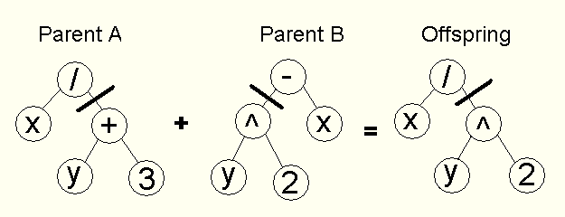
Tree encoding
Value Encoding

Slide 14
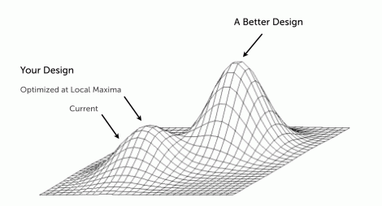
Local optimum Vs Global optimum

Slide 15
Selection methods
Roulette-Wheel selection
Boltzmann Selection
Tournament Selection
Rank Selection
Steady state selection
Elitism

Slide 16
Popularity Diversity
Genes from already discovered good are exploited while promising new areas of the search space continue to be explored
Selective reassure
Degree to which the better individuals are favored

Slide 17
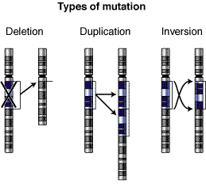
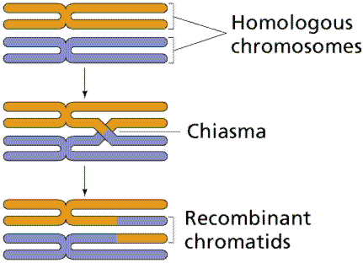
Crossovers and Mutations

Slide 18
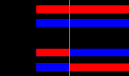
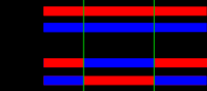

cross over variations
One-point crossover | Two-point crossover (Multi point) | Cut and splice”

Slide 19
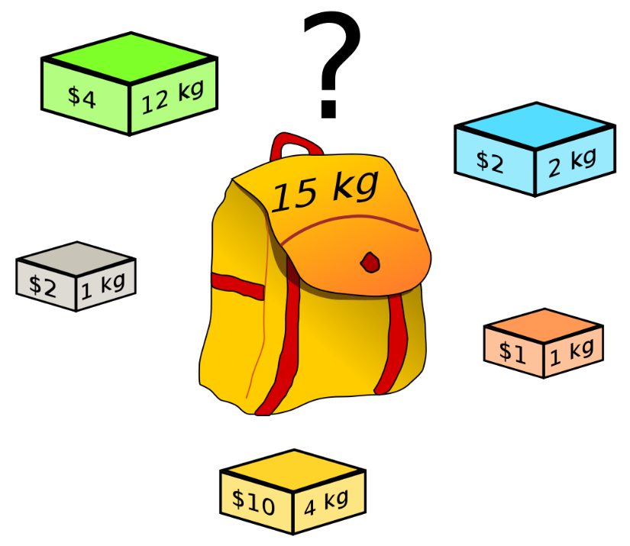
Lets try Knapsack-Problem
which boxes should be chosen to maximize the amount of money while still keeping the overall weight under or equal to 15 kg?
Item | Weight | Value
A | 12 | 4
B | 2 | 2
C | 1 | 2
D | 1 | 1
E | 4 | 10

Slide 20
Encoding
For Simplicity, Assume you can take only 1 from each item.
Lets put 1 if item is selected and 0 if item is not selected.
Then a possible solution would looks like
[ 1 , 0 , 0 , 1, 1]

Slide 21
Implementation in MATLAB
Lets Solve TSP using GA
B
D
C
A
F
E

Slide 22

Description of the problem
Six towns are connected with a network of roads. Traveling between different towns have different costs.
A sales man wants to visit all these cities with minimum cost.
Since his goods are low quality he doesn’t want to return to same city twice ;)
He can start his journey from any city and end at any city

Slide 23
Distances Between Cities
City | A | B | C | D | E | F
A | 0 | 10 | 15 | 40 | 25 | 30
B | 10 | 0 | 12 | 20 | 45 | 10
C | 15 | 12 | 0 | 80 | 02 | 15
D | 40 | 20 | 80 | 0 | 12 | 43
E | 25 | 45 | 02 | 12 | 0 | 80
F | 30 | 10 | 15 | 43 | 80 | 0

Slide 24
Solution format
Answer we expect is in the format of an ordered list of cities.
We can take each city as a gene
Manipulating genes would mean changing the order of genes, ‘ cities’.
Since each city must be visited once and only once resulting answer (chromosome) would have a fix length of 6. (But other variations of TSP may need dynamic size)
A B D F C E
C B D F A E
A B F D C E

Slide 25
Mutation
Since we don’t need duplications within the chromosome it is easy to focus only on mutation rather than cross over.
Mutation consist from selecting two random positions and swapping the elements at those places.
A B D F C E
C B D F A E
A B F D C E

Slide 26

Fitness function
Unlike some other problems we do not need heuristics or assumptions to calculate the fitness. Distance can be calculated directly.
Since we need to MINIMIZE the distance fitness is taken as the inverse of distance. So when distance get smaller fitness value increases.

Slide 27

Validating
It is important to check the validity of the solution before passing the mutated solution to the fitness evaluator. Other wise we may end up from getting invalid answer s to crashing the whole program!
So a validity function check ,each solution has each city once and only once.

Slide 28

Variations
Can you think of changes needed to be made if salesman was allowed to visit single city more than once.
What if there were one way roads ?
If we were to connect these cities via telephone cables what modification would be needed to be done to the algorithm to find the minimum cost.

Slide 29

Questions
How do we define the fitness function?
If we do not know the final answer how can we know how close we are to the solution ?
What role do heuristics play in the GA ?
How can we select a good heuristic ?

Slide 30
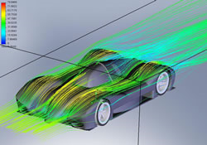
Automotive Design
Using Genetic Algorithms [GAs] to both design composite materials and aerodynamic shapes for race cars and regular means of transportation (including aviation) can return combinations of best materials and best engineering to provide faster, lighter, more fuel efficient and safer vehicles.
Rather than spending years in laboratories working with polymers, wind tunnels and balsa wood shapes, the processes can be done much quicker and more efficiently by computer modeling using GA searches to return a range of options human designers can then put together however they please.

Slide 31
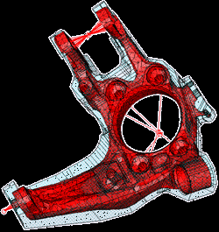
Engineering Design
Getting the most out of a range of materials to optimize the structural and operational design of buildings, factories, machines, etc. is a rapidly expanding application of GAs. These are being created for such uses as optimizing the design of heat exchangers, robot gripping arms, satellite booms, building trusses, flywheels, turbines, and just about any other computer-assisted engineering design application.
There is work to combine GAs optimizing particular aspects of engineering problems to work together, and some of these can not only solve design problems, but also project them forward to analyze weaknesses and possible point failures in the future so these can be avoided.

Slide 32
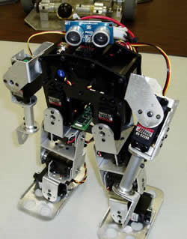
Robotics
Robotics involves human designers and engineers trying out all sorts of things in order to create useful machines that can do work for humans. Each robot's design is dependent on the job or jobs it is intended to do, so there are many different designs out there.
GAs can be programmed to search for a range of optimal designs and components for each specific use, or to return results for entirely new types of robots that can perform multiple tasks and have more general application. GA-designed robotics just might get us those nifty multi-purpose, learning robots we've been expecting.

Slide 33
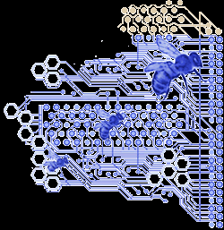
Evolvable Hardware
Evolvable hardware applications are electronic circuits created by GA computer models that use stochastic (statistically random) operators to evolve new configurations from old ones. As the algorithm does its thing in the running model, eventually a circuit configuration will come along that does what the designer wants.
Think of reconfigurable circuits in something like a space robot. It could use a built-in GA library and simulator to re-design itself after something like radiation exposure that messes up its normal configuration, or encounters a novel situation in which it needs a function it doesn't already have. Such GAs would enable self-adaptation and self-repair.

Slide 34

Optimized Telecommunications Routing
Do you find yourself frustrated by slow LAN performance, inconsistent internet access, a FAX machine that only sends faxes sometimes, your land line's number of 'ghost' phone calls every month? Well, GAs are being developed that will allow for dynamic and anticipatory routing of circuits for telecommunications networks.
These could take notice of your system's instability and anticipate your re-routing needs. Using more than one GA circuit-search at a time, soon your interpersonal communications problems may really be all in your head rather than in your telecommunications system.
Other GAs are being developed to optimize placement and routing of cell towers for best coverage and ease of switching, so your cell phone and blackberry will be thankful for GAs too.

Slide 35

Joke Generation!
Among the linguistic applications of GAs - including a JAPE (automated pun generator) inspired STANDUP program to design communications strategies for people working with children who suffer communications disabilities - are GAs that search for jokes and puns.
These come under the heading of "artificial creativity" and AI, but could prove very useful to class clowns and wannabe punsters whose public reputations depend upon being funnier than they actually are.
These clever GAs will let you input a word you wish to pun or a subject you'd like to joke about, and will return a variety of solutions that just might lead to a lucrative career on the comedy club circuit!

Slide 36
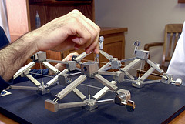
Biomimetic Invention
Biomimicry or biomimetics is the development of technologies inspired by designs in nature. Since GAs are inspired by the mechanisms of biological evolution, it makes sense that they could be used in the process of invention as well.
GAs rely primarily on something called implicit parallelism (like to like), using mutation and selection in secondary roles toward a design solution.
A programmers are working on applications that not only analyze the natural designs themselves for a return on how they work, but can also combine natural designs to create something entirely new that can have exciting applications.

Slide 37
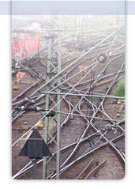
Trip, Traffic and Shipment Routing
New applications of a GA known as the "Traveling Salesman Problem" or TSP can be used to plan the most efficient routes and scheduling for travel planners, traffic routers and even shipping companies. T
he shortest routes for traveling. The timing to avoid traffic tie-ups and rush hours. Most efficient use of transport for shipping, even to including pickup loads and deliveries along the way.
The program can be modeling all this in the background while the human agents do other things, improving productivity as well! Chances are increasing steadily that when you get that trip plan packet from the travel agency, a GA contributed more to it than the agent did.

Slide 38

Computer Gaming
Those who spend some of their time playing computer Sims games (creating their own civilizations and evolving them) will often find themselves playing against sophisticated artificial intelligence GAs instead of against other human players online.
These GAs have been programmed to incorporate the most successful strategies from previous games - the programs 'learn' - and usually incorporate data derived from game theory in their design. Game theory is useful in most all GA applications for seeking solutions to whatever problems they are applied to, even if the application really is a game.

Slide 39
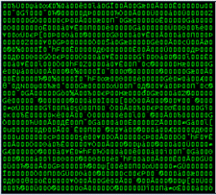
Encryption and Code Breaking
On the security front, GAs can be used both to create encryption for sensitive data as well as to break those codes. Encrypting data, protecting copyrights and breaking competitors' codes have been important in the computer world ever since there have been computers, so the competition is intense.
Every time someone adds more complexity to their encryption algorithms, someone else comes up with a GA that can break the code. It is hoped that one day soon we will have quantum computers that will be able to generate completely indecipherable codes.
Of course, by then the 'other guys' will have quantum computers too, so it's a sure bet the spy vs. spy games will go on indefinitely.

Slide 40
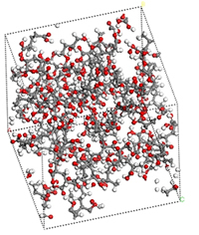
Computer-Aided Molecular Design
The de novo design of new chemical molecules is a burgeoning field of applied chemistry in both industry and medicine.
GAs are used to aid in the understanding of protein folding, analyzing the effects of substitutions on those protein functions, and to predict the binding affinities of various designed proteins developed by the pharmaceutical industry for treatment of particular diseases.
The same sort of GA optimization and analysis is used for designing industrial chemicals for particular uses, and in both cases GAs can also be useful for predicting possible adverse consequences. This application has and will continue to have great impact on the costs associated with development of new chemicals and drugs.

Slide 41
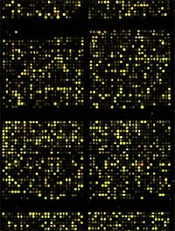
Gene Expression Profiling
The development of microarray technology for taking 'snapshots' of the genes being expressed in a cell or group of cells has been a boon to medical research. GAs have been and are being developed to make analysis of gene expression profiles much quicker and easier.
This helps to classify what genes play a part in various diseases, and further can help to identify genetic causes for the development of diseases. Being able to do this work quickly and efficiently will allow researchers to focus on individual patients' unique genetic and gene expression profiles, enabling the hoped-for "personalized medicine" we've been hearing about for several years.

Slide 42
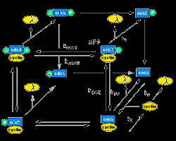
Optimizing Chemical Kinetic Analysis
In the not-so rarified realm of fuels and engines for combustion technologies, GAs are proving very useful toward optimizing designs in transportation, aerospace propulsion and electrical generation.
By being able to predict ahead of time the chemical kinetics of fuels and the efficiency of engines, more optimal mixtures and designs can be made available quicker to industry and the public. Some computer modeling applications in this area also simulate the effectiveness of lubricants and can pinpoint optimized operational vectors, and may lead to greatly increased efficiency all around well before traditional fuels run out.

Slide 43
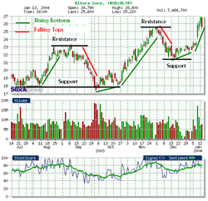
Finance and Investment Strategies
In the current unprecedented world economic meltdown one might legitimately wonder if some of those Wall Street gamblers made use of GA-assisted computer modeling of finance and investment strategies to funnel the world's accumulated wealth into what can best be described as dot-dollar black holes.
But then again, maybe they were simply all using the same prototype, which hadn't yet been de-bugged. It is possible that a newer generation of GA-assisted financial forecasting would have avoided the black holes and returned something other than bad debts the taxpayers get to repay. Who knows?

Slide 44

Marketing and Merchandising
We could think the word 'merchandising' just the way Mel Brooks said it in the "Space Balls" the movie. Space Balls the toilet paper. Space Balls the lunchbox. Space Balls the flame thrower... And laugh because it's close enough to reality to be funny.
So it shouldn't surprise anyone that GAs are indeed being put to work to help merchandisers to produce products and marketing consultants design advertising and direct solicitation campaigns to sell stuff.
Maybe this application of GAs could someday get us out of the financial black hole and get things moving again.

Slide 45

References
Artificial Intelligence application programming M.T.Jones
Artificial Intelligence
Elaine Rich

Slide 46
Notes
gd_illeperuma@yahoo.com

Slide 47
Warm up
Create a 10 by 1 matrix with random numbers. Sort it using ascending order.
Create a 10 by 2 matrix. First column consist of random numbers, second column consist numbers from 1 to 10.
Sort the rows in descending order using sortrows command

Slide 48
x and y are two 1 by 5 matrices. (you can use any numbers you want for x and y)
Calculate z; where zi = xi * yi
Create function for it

